Slide 1
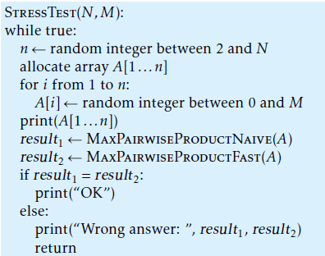
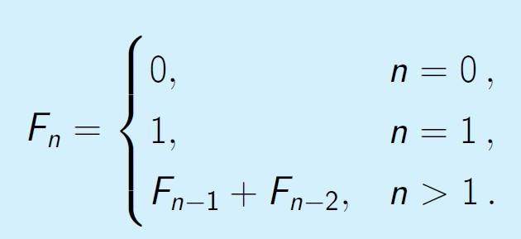
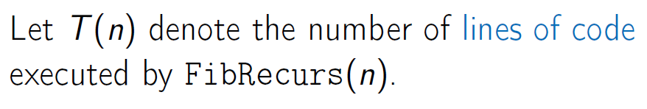
Algorithmic Toolbox
Week 1 Programming Challenges
Stress testing:
Your implementation of an algorithm
An alternative, trivial and slow, but correct implementation of an algorithm for the same problem
A random test generator
An infinite loop in which a new test is generated and fed into both implementations to compare the results. If their results differ, the test and both answers are output, and the program stops, otherwise the loop repeats.
Week 2 Algorithmic Warm-up
Fibonacci Numbers:
Problem Overview

Slide 2
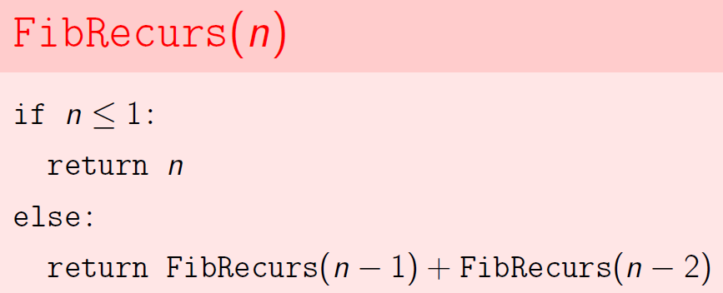
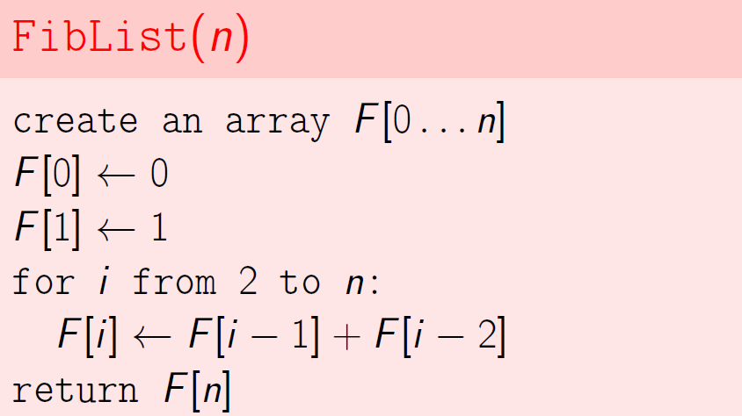
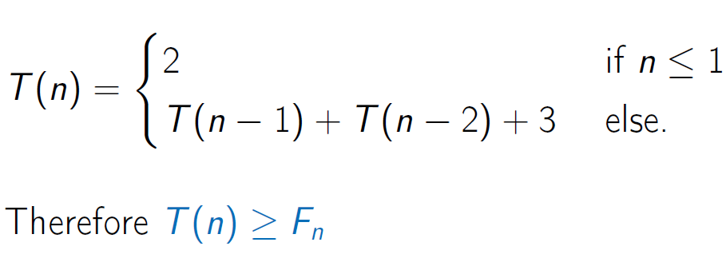
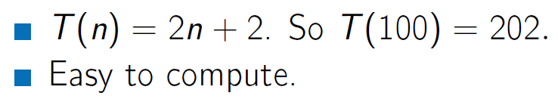
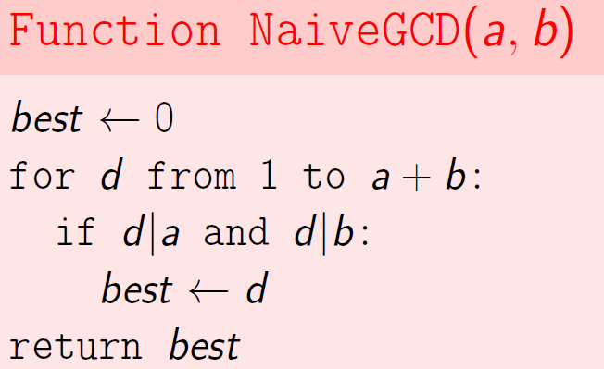
Naïve Algorithm and Running Time
New Algorithm and Running Time
Greatest Common Divisors:
Naïve Algorithm and Running Time
Runtime approximately a + b

Slide 3
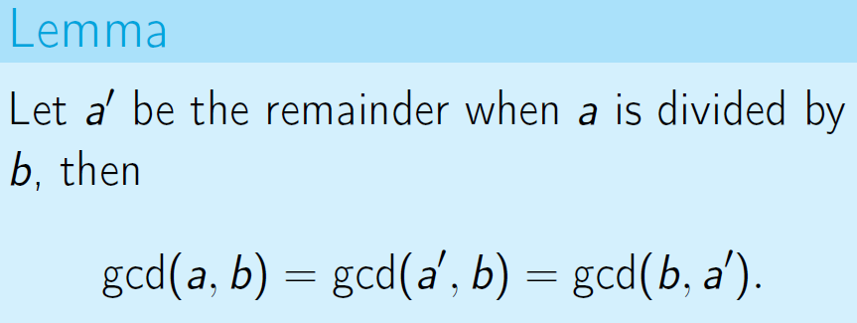
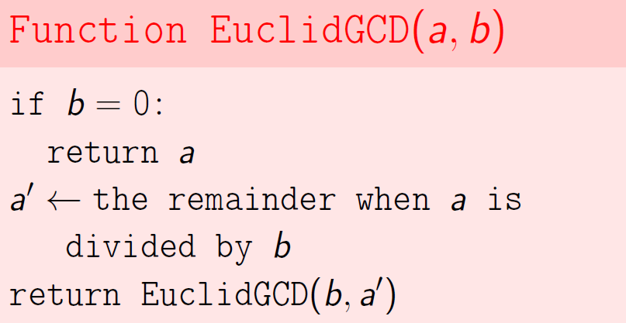
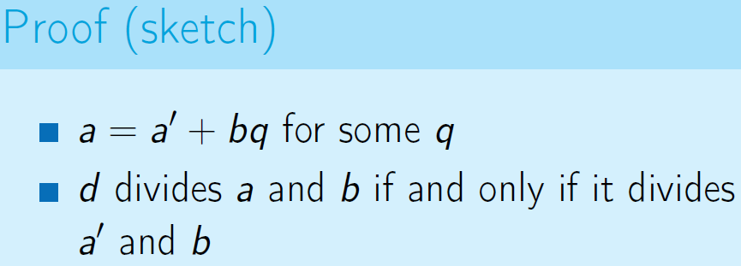
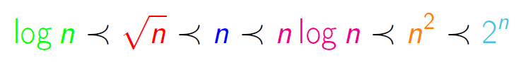
New Algorithm and Running Time
Takes about log(ab) steps and each step a single division
Computing Runtimes:
Actual runtimes depends on speed of the computer, system architecture, used complier, details of the memory hierarchy
Asymptotic Notation
Idea: all of these details can multiply runtimes by (large) constant. So measure runtime in a way that ignores constant multiples

Slide 4
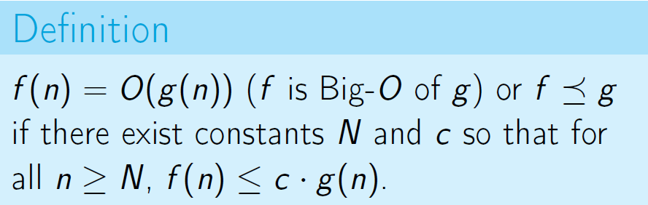
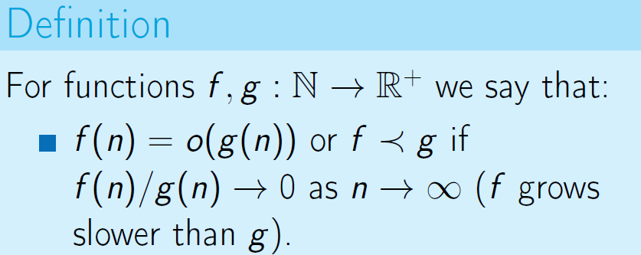
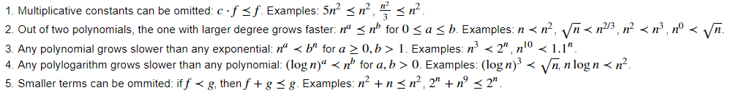
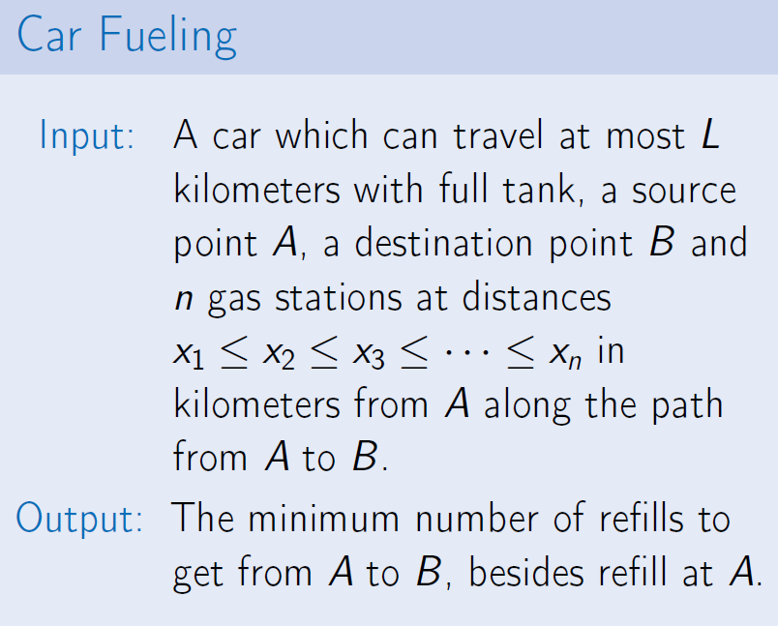
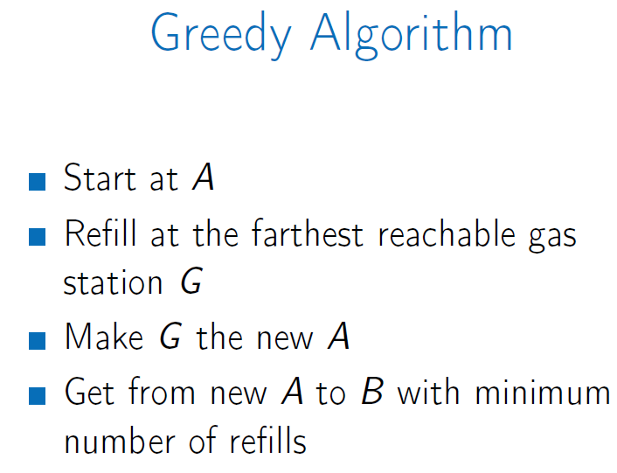
Big-O Notation
Week 3 Greedy Algorithms
Largest Number:
Find Max digit → Append it to the number → Remove it from the list → Repeat
Greedy Strategy:
Make some greedy choice
Reduce to a smaller problem
Iterate
Car Fueling

Slide 5
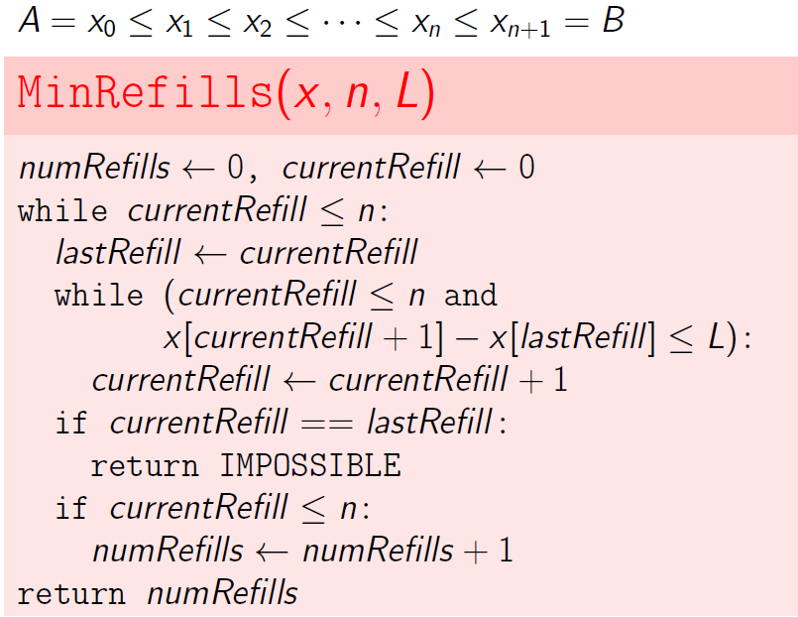
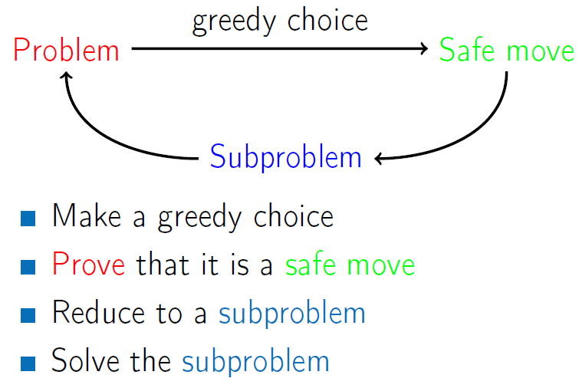
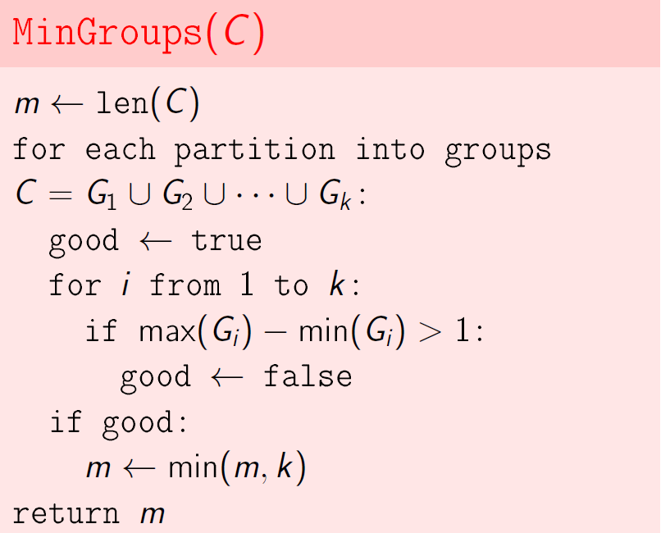
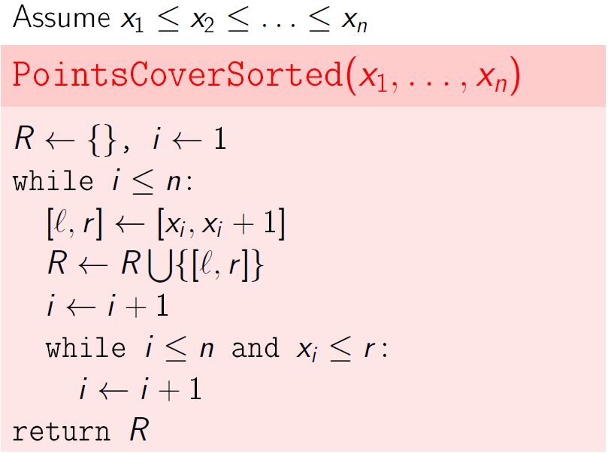
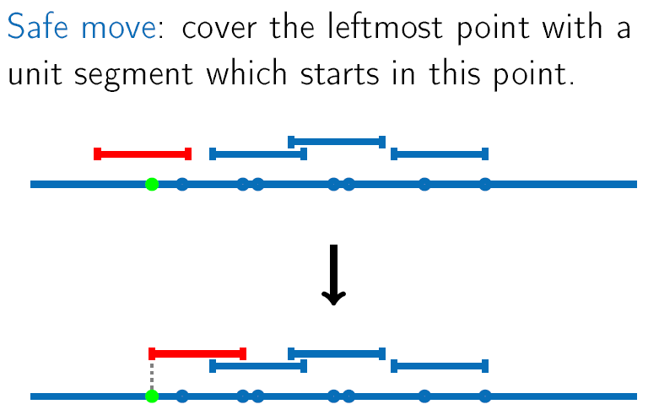
Car Fueling Implementation and Running Time is O(n):
General Greedy Strategy
Grouping Children: min number of group that age of any tow children in the group is less than 1year
2^n
O(n)

Slide 6
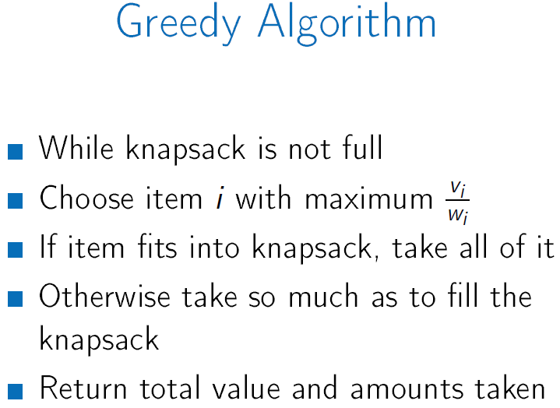
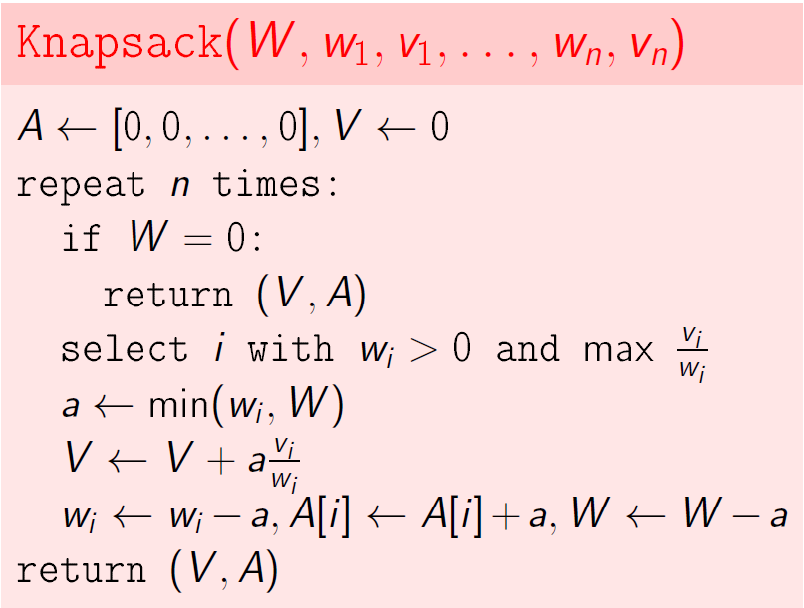
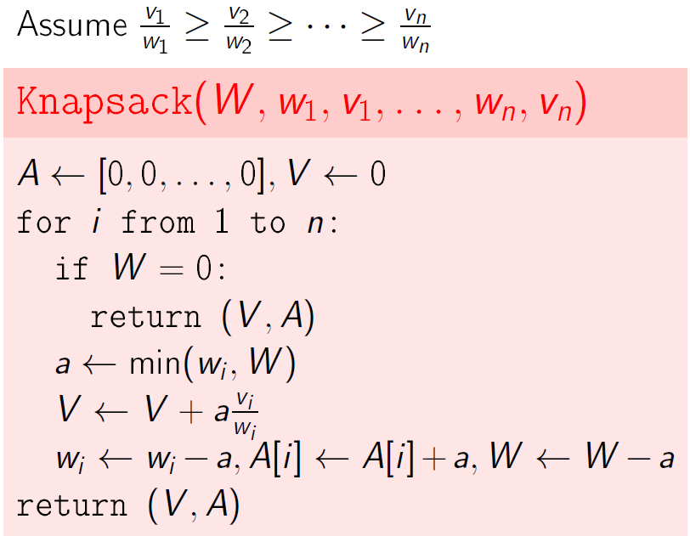
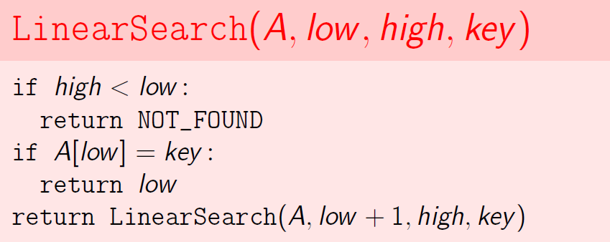
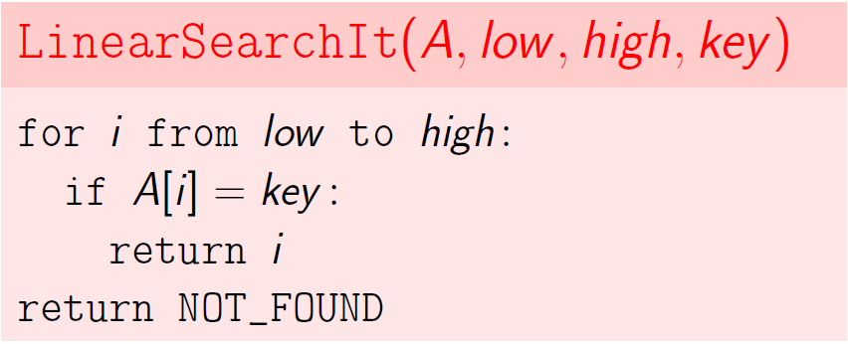
Sort {X1…Xn} is O(nlogn) and PointsCoverSorted is O(n), so total is O(nlogn)
Fractional Knapsack:
Sort Items
O(n^2)
O(nlogn)
Greedy move can be faster after sorting
Week 4 Divide-and-Conquer
Divide and conquer: Break into non-overlapping subproblems of the same type → Solve subproblems → Combine Results
Linear search: return index I, where A[i] = k
Recurrence worst-case time is T(n)=T(n-1)+c and T(0)=c, so the running time is O(n)

Slide 7
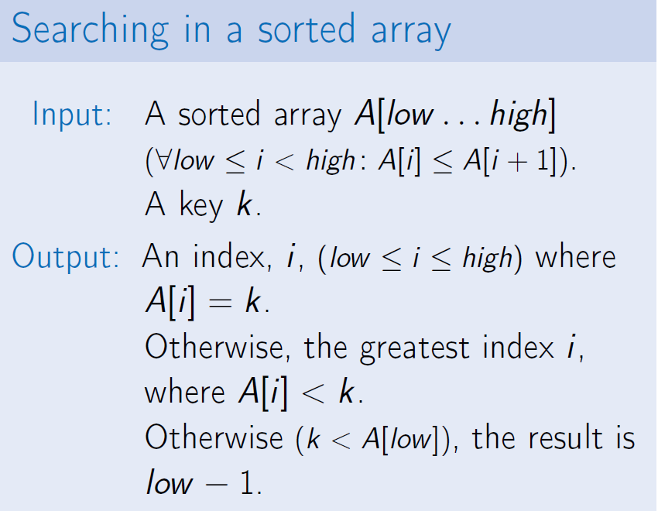
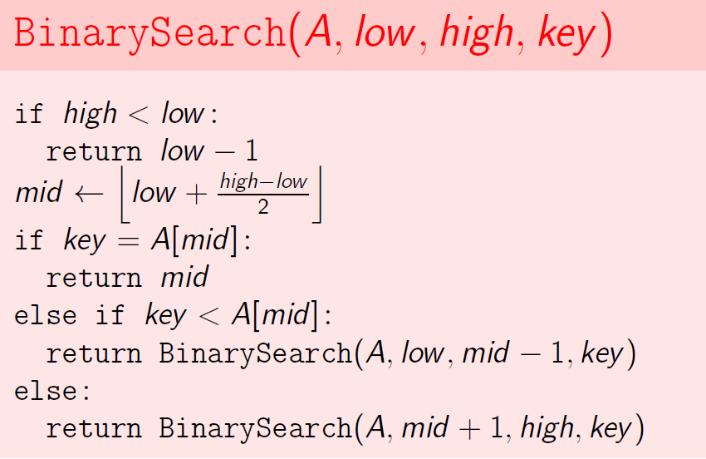
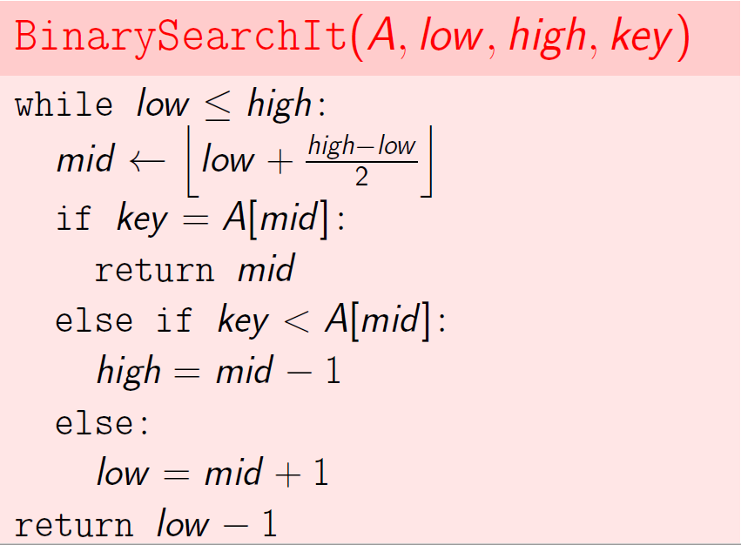
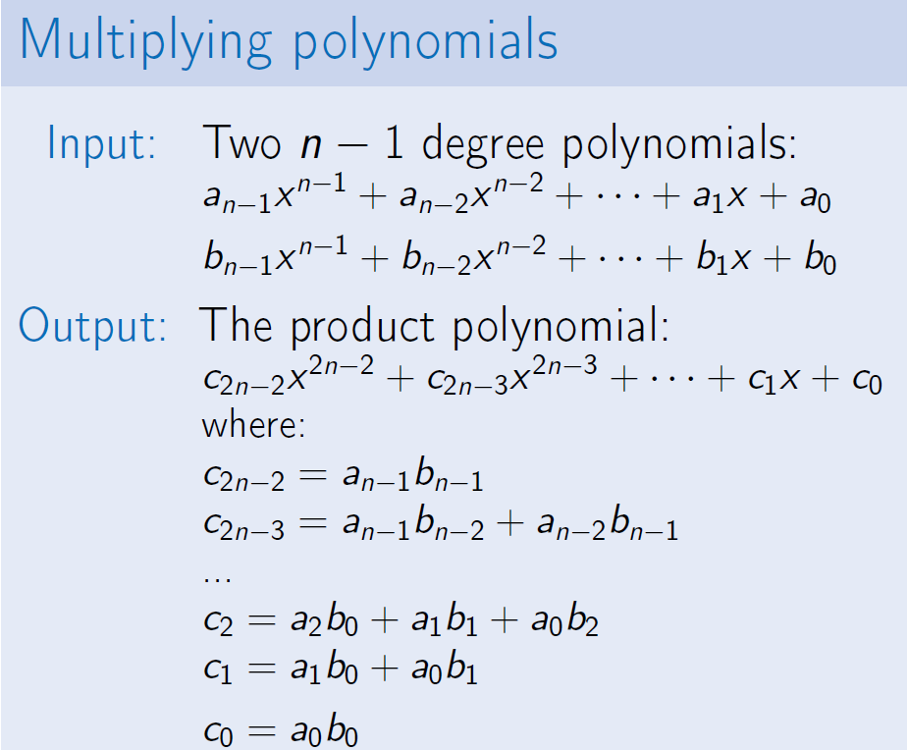
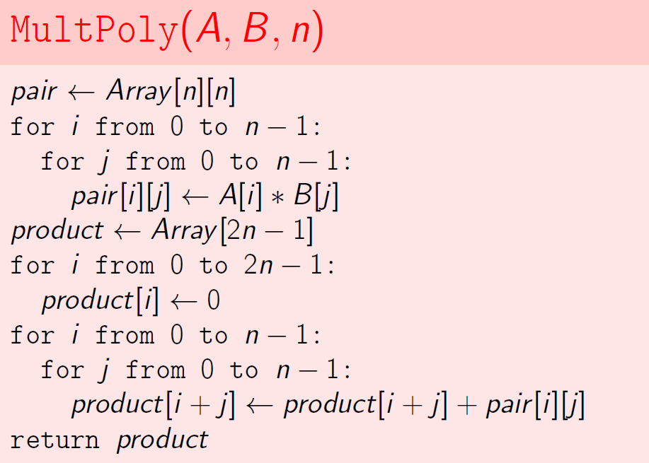
Binary Search: recurrence relation is T(n) = T(n/2)+c and T(0)=c, so running time is O(log₂n)
Polynomial Multiplication:
Naïve Algorithm
O(n^2)

Slide 8
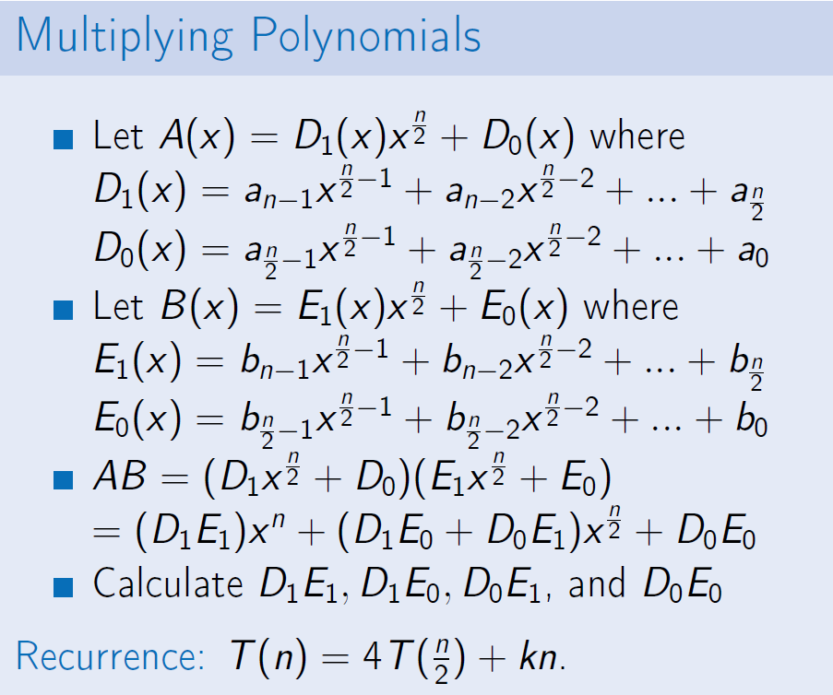
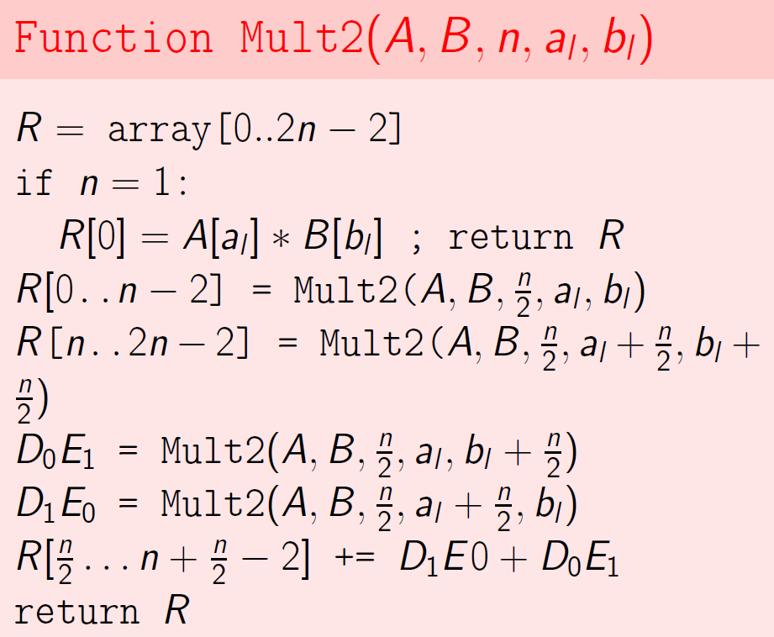
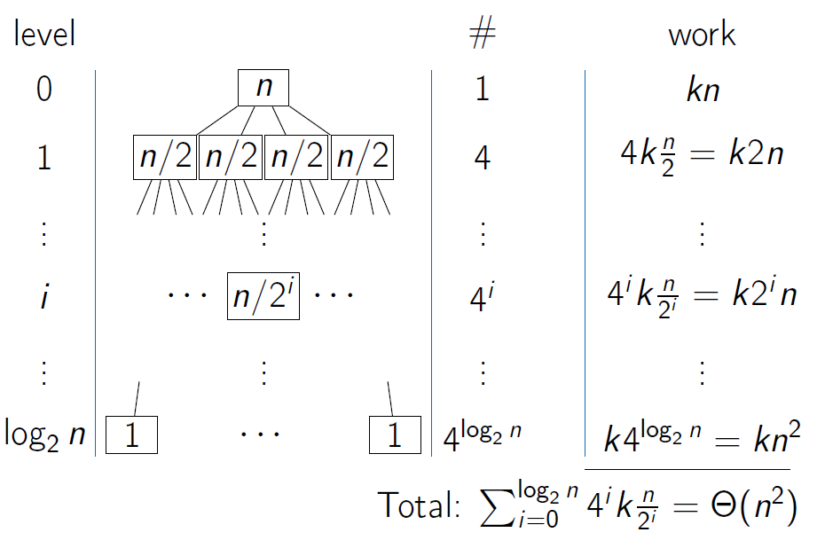
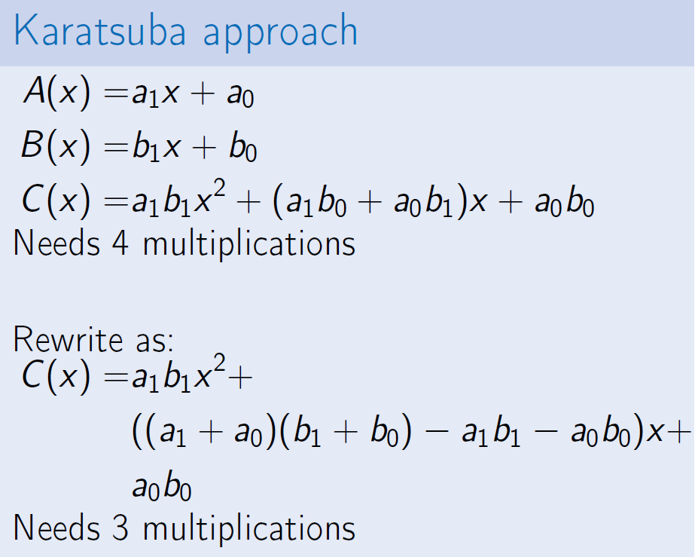
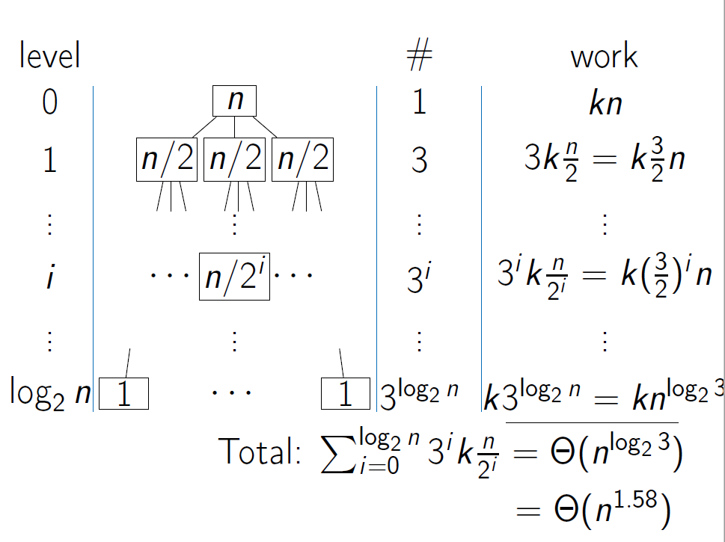
Naïve Divide and Conquer Algorithm
Faster Divide and Conquer Algorithm

Slide 9
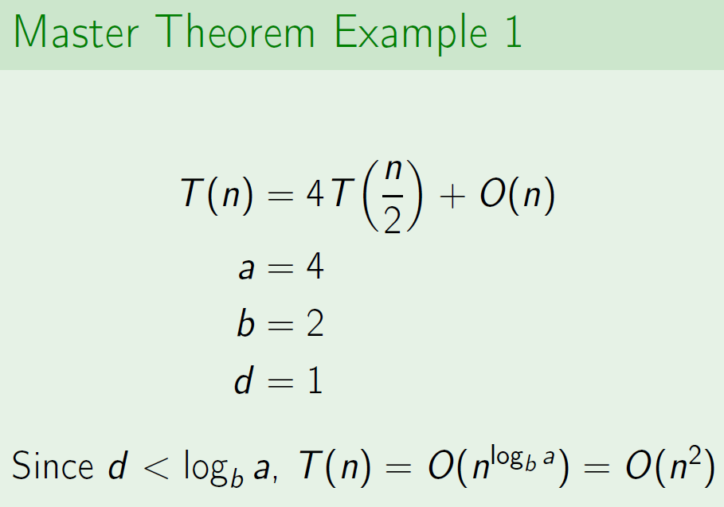
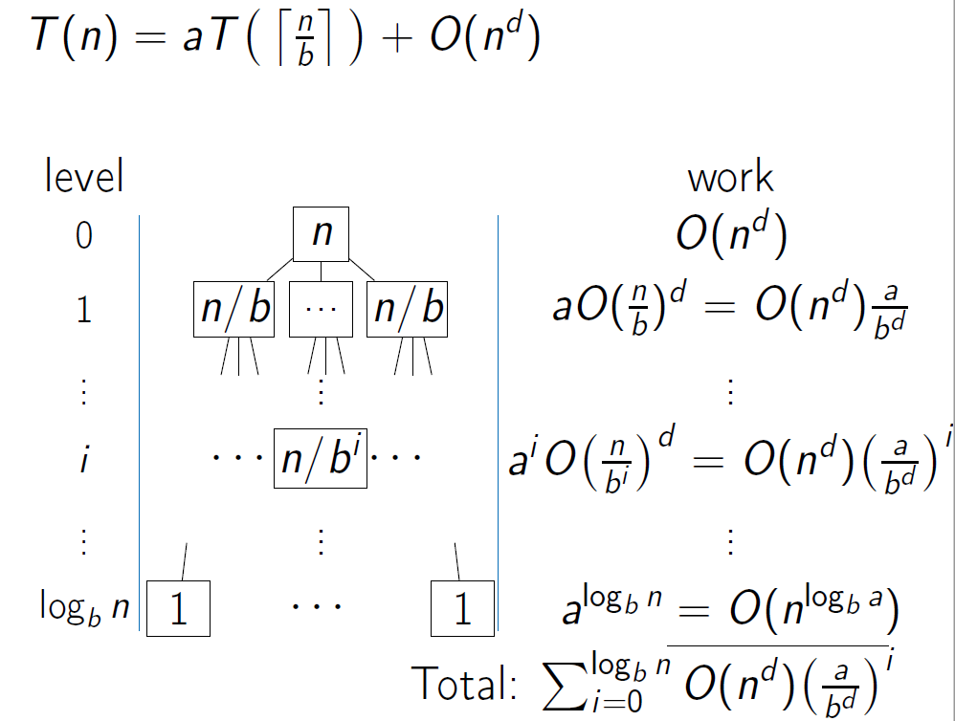
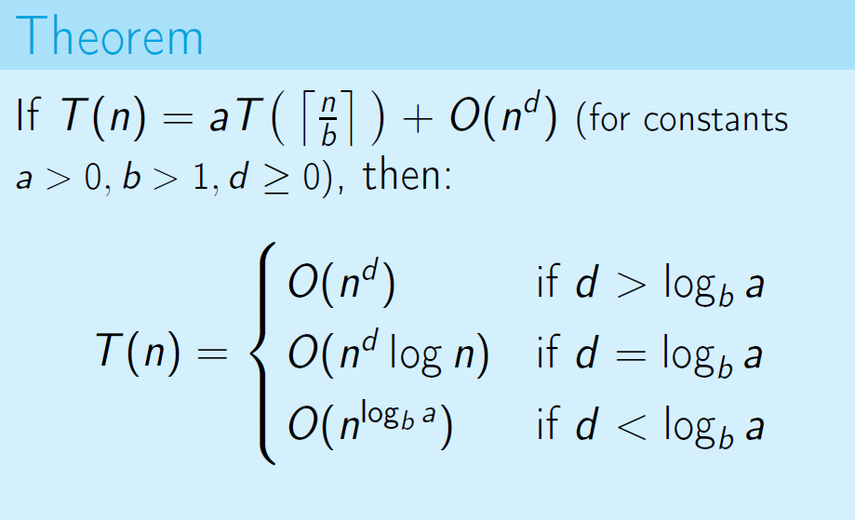
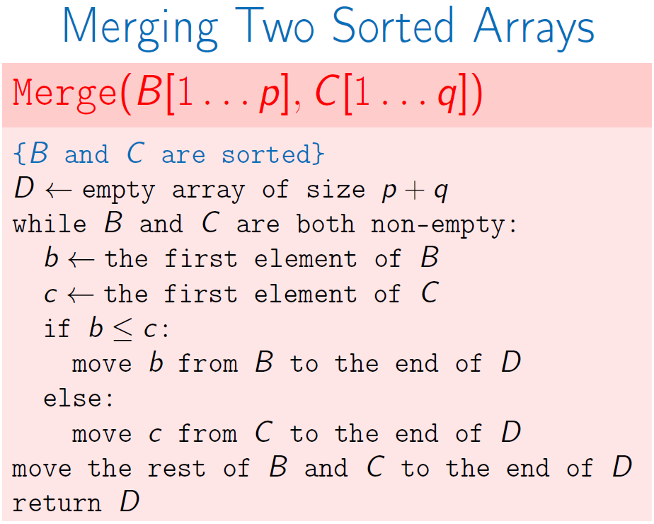
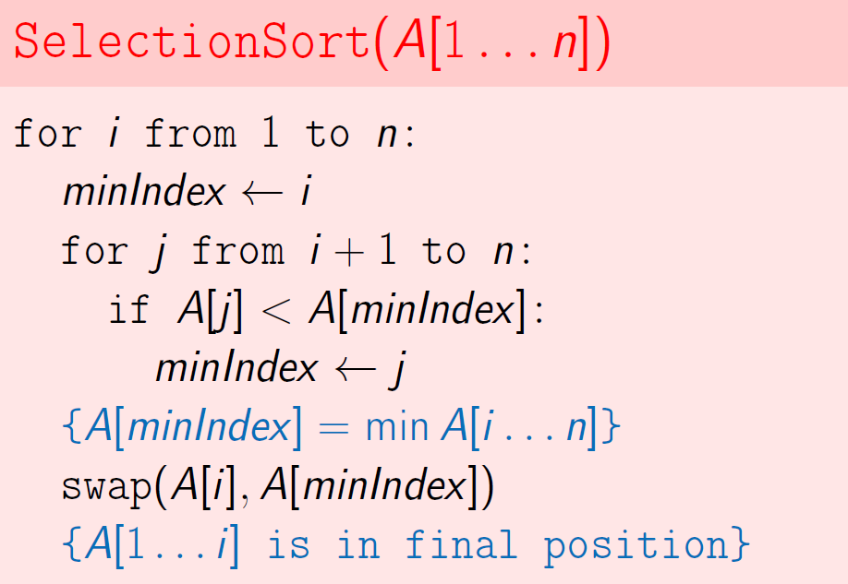
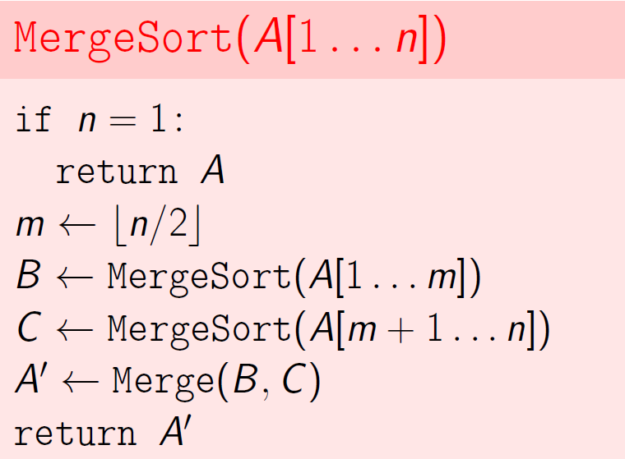
Master Theorem:
Sorting Problem:
Selection sort: find a minimum by scanning the array and swap it the 1st element.
Merge sort: split into two halves and merge the sorted halves into one array
T(n) <= 2T(n/2)+O(n)
So it is O(nlogn)
O(n)
O(n²)

Slide 10
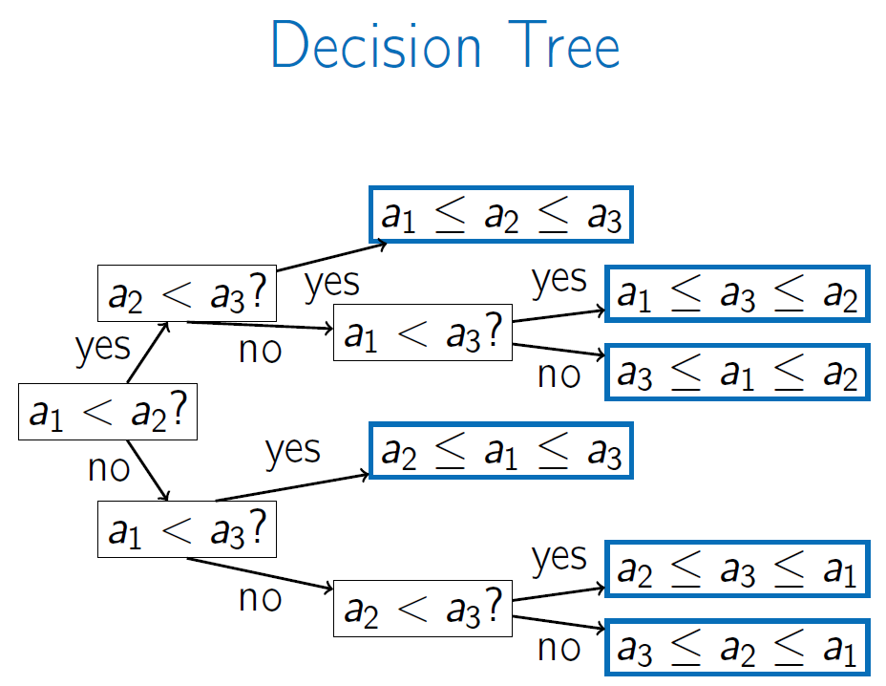
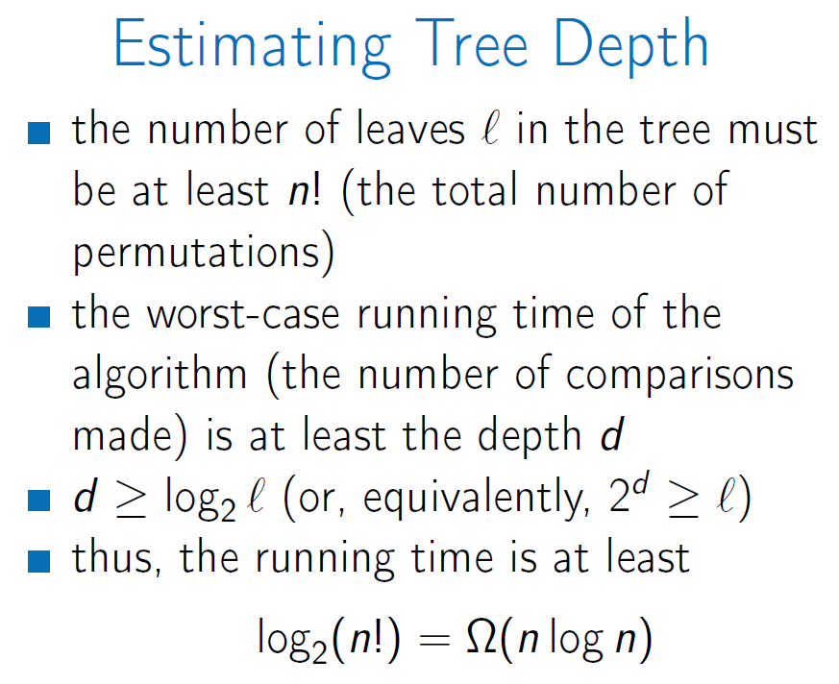
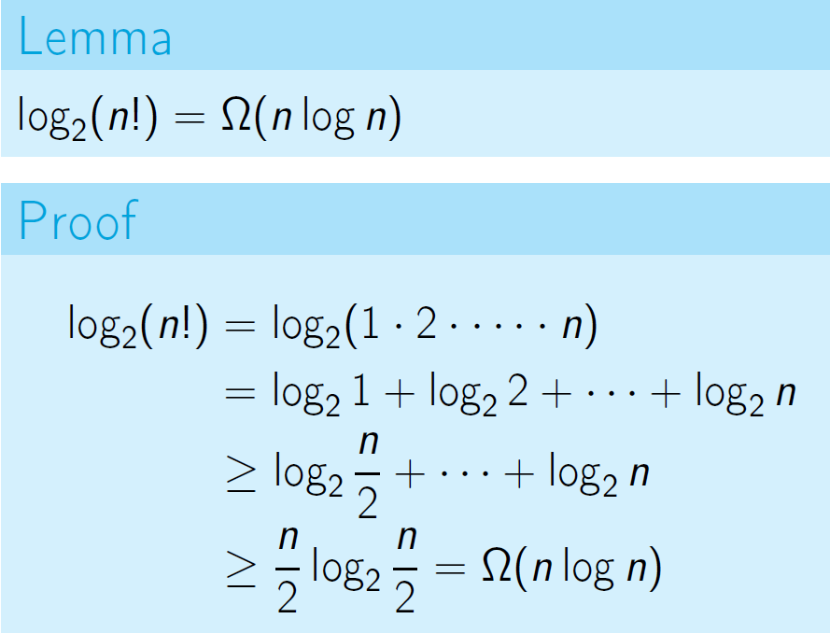
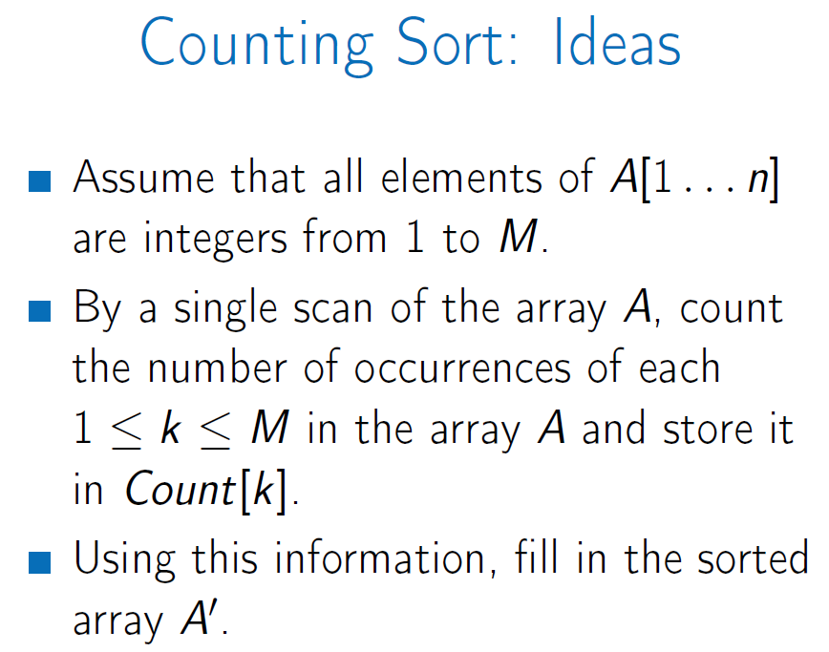
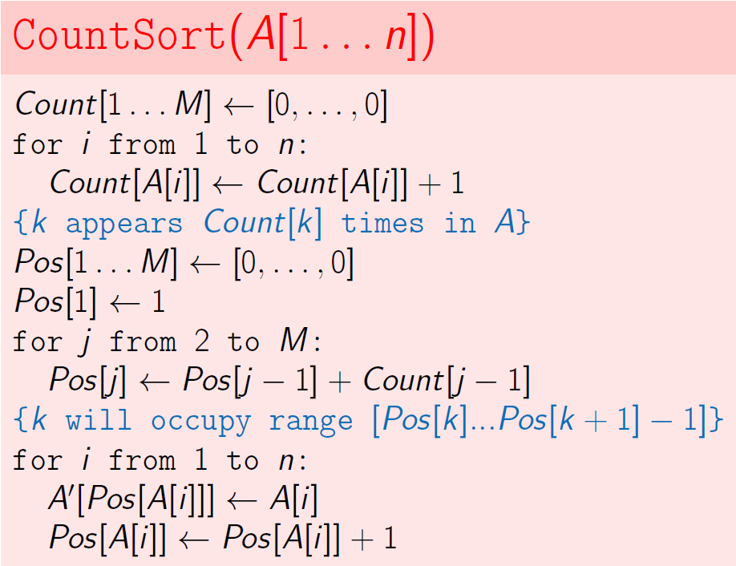
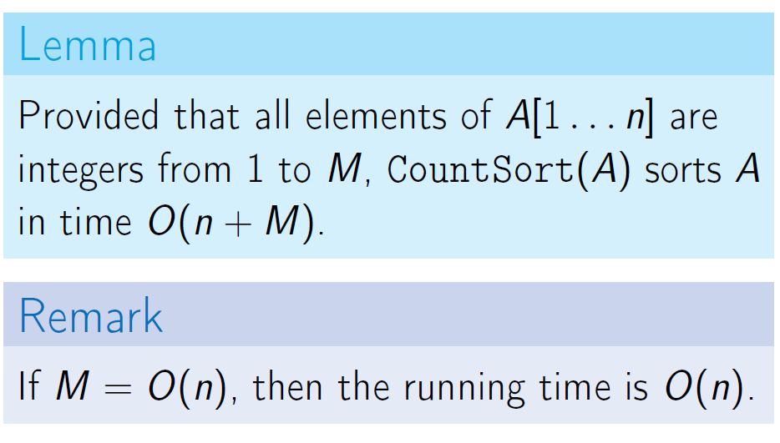
Lower Bound for Comparison Based Sorting: selection sort and merge sort
Any comparison based sorting algorithm performs O(nlogn) in the worst case
Non-comparison based sorting algorithms: sorting small integers using counting sort

Slide 11
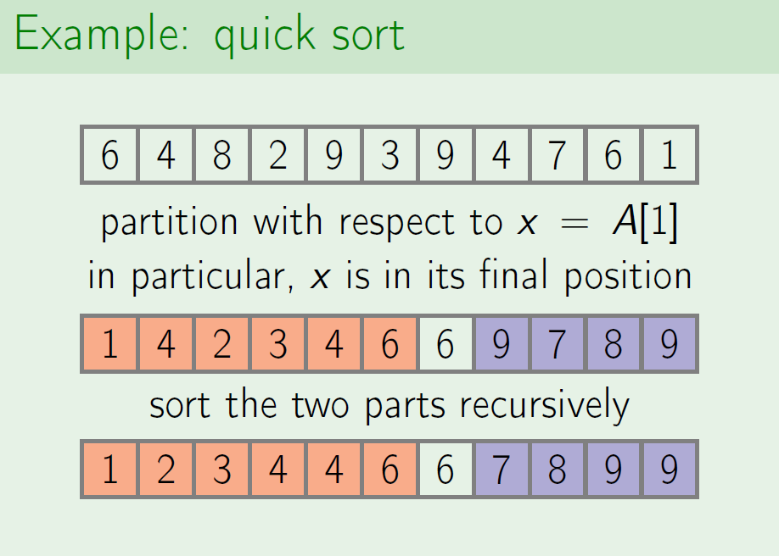






Quick Sort:
Random pivot:
Equal elements:

Slide 12







Algorithm Sketch of Quick Sort and Random Pivot
Week 5 Dynamic Programming1
Change Problem: find min number of coins needed to make change
Greedy Change: Greedy is not Optimal
Recursive Change

Slide 13








How fast is RecursiveChange?
Dynamic Programming
For Denominations 6, 5 and 1

Slide 14







String Comparison: find min number of coins needed to make change
Alignment Game:
Minimizing edit distance = maximizing alignment score

Slide 15






Computing Edit Distance:
Let D(i, j) be the edit distance of an i-prefix A[1…i] and a j-prefix B[1…j]

Slide 16







Reconstructing an Optimal Alignment:
Warm-up
Longest Increasing Subsequence
Subproblems and Recurrence Relation
Using Fibonacci numbers as an example.
The recursion algorithm has a lot of recomputing. Many computations are repeated.
The list algorithm to store all previous computing will waste a lot of space.
O(n) addition and less space used.
The key idea of dynamic programming: avoid recomputing the same thing again.

Slide 17






Reconstructing a Solution
For each subproblem we will keep its optimal value and a choice leading to this value
O(n^2)
We need to store in the table T the value of LIS(i) for all I from 0 to n-1.
Data structure for T is an array of size n. Fill in this array iteratively instead of recursively.

Slide 18






Start with an empty sequence
Extend it element by element recursively
Keep track of the length of the sequence
Subproblems is the most important ingredient of a dynamic programming algorithm.
To arrive at right subproblem:
Analyze the structure of an optimal solution
Implement a brute force solution and optimize it

Slide 19






Edit Distance (Levenshtein distance): min # of insertions, deletions, and substitutions needed to transform A string to B.
Fill in the table row by row or column by column

Slide 20





Knapsack:
w Repeats Optimal Solution
Consider an optimal solution and an item in it (w_{i})
If we take this item out then we get an optimal solution for a knapsack of total weight W - w_{i}
Can take fractions of item
Dynamic Programming, Greedy doesn’t work
Taken or not

Slide 21






Gradually fill in an array T: T[u]=value(u)
w/o Repeats Optimal Solution

Slide 22




Running time: O(nW)
Space: O(nW)
Space can be improved to O(W) in the iterative version: instead of string the whole table, store the current column and the previous one
If all subproblems must be solved then an iterative algorithm is faster since it has no recursion overhead.
The running time is O(n2^{logW})

Slide 23




Chain matrix multiplication: the cost of multiplying two matrices of size p*q and q*r is pqr
Summary:
Step 1: Define subproblems and a recurrence relation (analyze optimal solution or optimize a brute force solution)
Step 2: Convert a recurrence relation into a recursive algorithm
Store solution to each subproblem in a table
Before solving a subproblem check whether it is already stored in the table
Step 3: Convert a recursive algorithm into an iterative algorithm
Prove an upper bound on the running time = # of subproblems x time to solve subproblems
Uncover a solution
Exploit the regular structure of the table to check whether space can be saved
O(n^3)

Slide 24






Week 6 Dynamic Programming2

Slide 25




